Slide 1
Router Access Restriction on VLAN Network

Slide 2
Abstract
An Organization uses a VLAN based network. There are 2 VLAN’s on the network, namely VLAN 1 , 2, 3 and 4. The VLAN’s are mapped with the IP networks192.168.1.0/24, 192.168.2.0/24
192.168.3.0/24 and 192.168.4.0/24 It is required that only a Particular VLAN should be able to get remote access of the router using telnet. All the other VLAN’s should be blocked. To demonstrate the solution a lab is setup with Cisco Packets Tracer to virtually demonstrate the topology of routers and switches and testing the workings of the above proposition.

Slide 3
Introduction
A virtual local area network is a logical subnetwork that groups a collection of devices from different physical LAN’s. Large Businesses often set up VLANs to re-partition a network for improved traffic management. Several kinds of physical networks support virtual LANs, including Ethernet and Wi-Fi.
Brings security benefits to larger networks by allowing greater control over which devices have local access to each other. (We are Mainly Focusing on this Point)
Virtual LANs improve the performance of busy networks.
Group client devices that communicate frequently with each other.
The traffic among devices split across two or more physical networks is usually handled more efficiently by switches via a VLAN.

Slide 4
Interpretation
Biggest Drawback of LAN
One of the biggest problem of a switch is that it creates a one large broadcast domain where a single broadcast generated from a user will be broadcasted to the network and all the other users in the same LAN will have to listen to the same broadcast even though it’s not addressed to them, it will also consume the Bandwidth of the network and the CPU cycle. To solve this problem, we can virtually break this one large broadcast domain into multiple domains. VLAN’s also allows us to provide security by denying access to members of one VLAN to another unless it was authorized

Slide 5
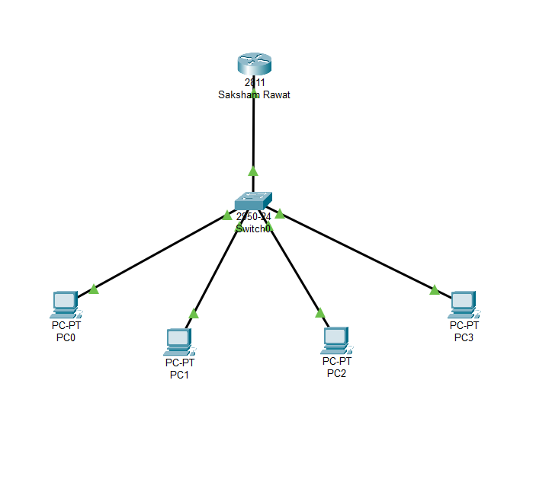
Architecture Design

Slide 6
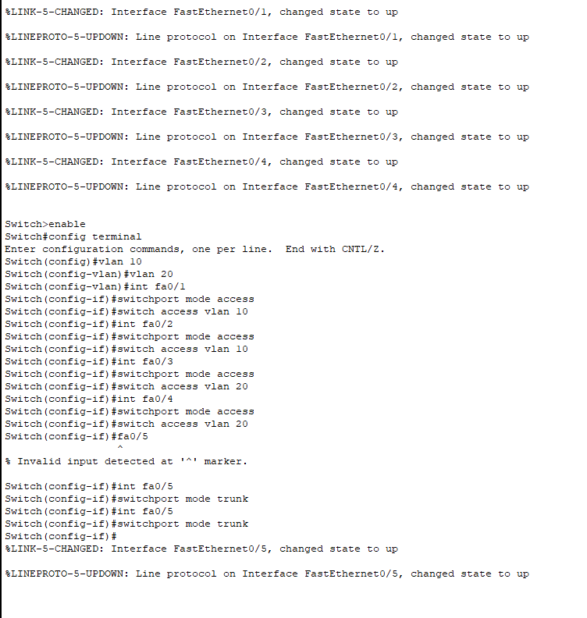

Slide 7
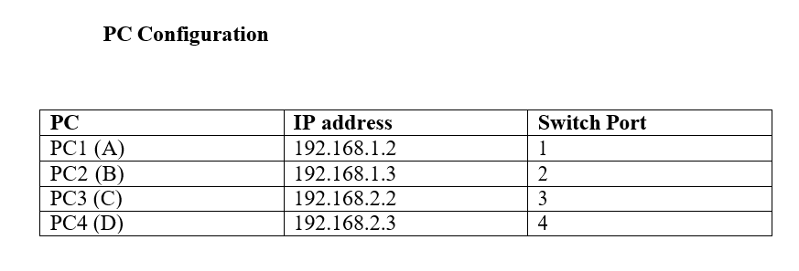
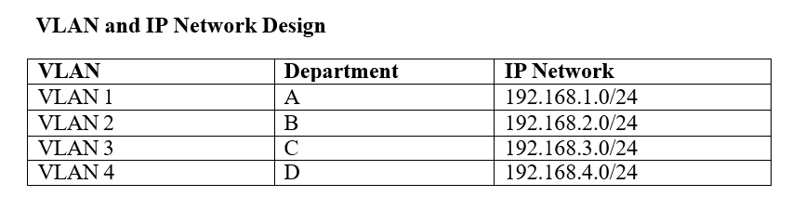

Slide 8
Results & Discussion
Router Access Restriction on VLAN Network was Implemented successfully using the Router on a Stick Method.

